Slide 1
CYB 110
Cybersecurity and privacy
Module 13 - Software security
Jim Alves-Foss and Jia Song

Slide 2
Outline
  Software security
  Software development life cycle (SDLC)
  Software design principles (Saltzer & Schroeder’s paper 1975)
    Least Privilege (need to know)
    Fail-safe Defaults
    Economy Of Mechanism
    Complete Mediation
    Separation Of Privilege Principle (Defense In Depth)
    Open Design
    Least Common Mechanism
    Least Astonishment

Slide 3
Outline
  Software security
  Software development life cycle (SDLC)
  Software design principles (Saltzer & Schroeder’s paper 1975)
    Least Privilege (need to know)
    Fail-safe Defaults
    Economy Of Mechanism
    Complete Mediation
    Separation Of Privilege Principle (Defense In Depth)
    Open Design
    Least Common Mechanism
    Least Astonishment

Slide 4
Software security
Software is a collection of instructions and data that tell a computer how to work.
Software bugs are errors, flaws, mistakes, or oversights in programs that result in unexpected and typically undesirable behavior.
Software vulnerabilities are specific flaws or oversights in a piece of software that allow attackers to do something malicious – expose or alter sensitive information, disrupt or destroy a system, or take control of a computer system or program.
Software security is the application of techniques that assess, mitigate, and protect software systems from vulnerabilities and attacks.

Slide 5
Outline
  Software security
  Software development life cycle (SDLC)
  Software design principles (Saltzer & Schroeder’s paper 1975)
    Least Privilege (need to know)
    Fail-safe Defaults
    Economy Of Mechanism
    Complete Mediation
    Separation Of Privilege Principle (Defense In Depth)
    Open Design
    Least Common Mechanism
    Least Astonishment

Slide 6
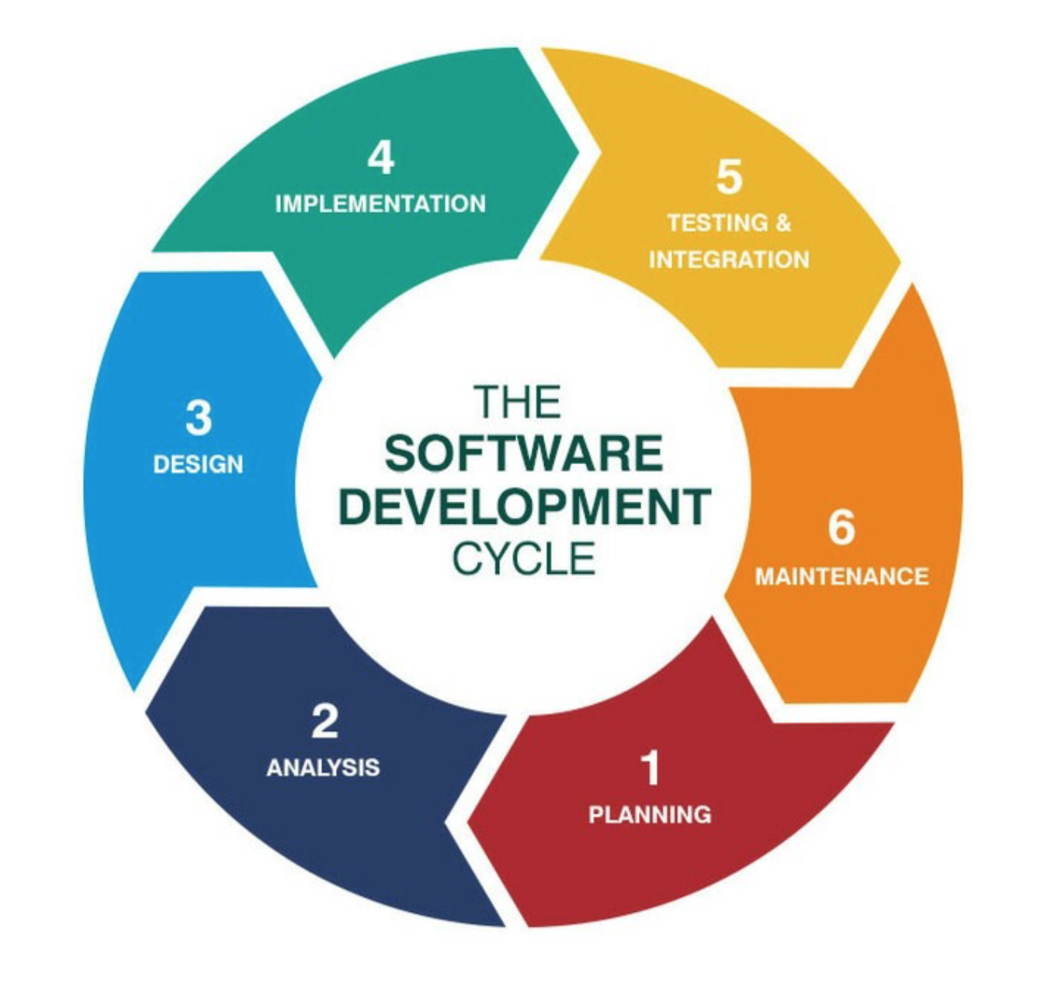
Software development life cycle (sdlc)
Software development life cycle describes phases of the software development cycle and the order in which those phases are executed.
Each phase produces deliverables required by the next phase in the life cycle.
Which stage should we start think about security?
Security should be considered as early as possible – from the planning phase.
Developing secure software involves considering security at every stage of the life cycle.

Slide 7
Classifying Vulnerabilities
  Design vulnerabilities - High-level issues with program architecture, requirements, base interfaces and key algorithms.
  Implementation Vulnerabilities - Security issues in the design of low-level program pieces, such as parts of individual functions and classes, are generally considered to be implementation vulnerabilities.
  Implementation vulnerabilities also include more complex logical elements that are not normally addressed in the design specification.

Slide 8
Classifying Vulnerabilities
Operational vulnerabilities – are security problems that arise through the operational procedures and general use of the piece of software in a specific environment.
  result from application’s configuration
  result from deployment environment
Responsibility falls between developer and administrative personnel.

Slide 9
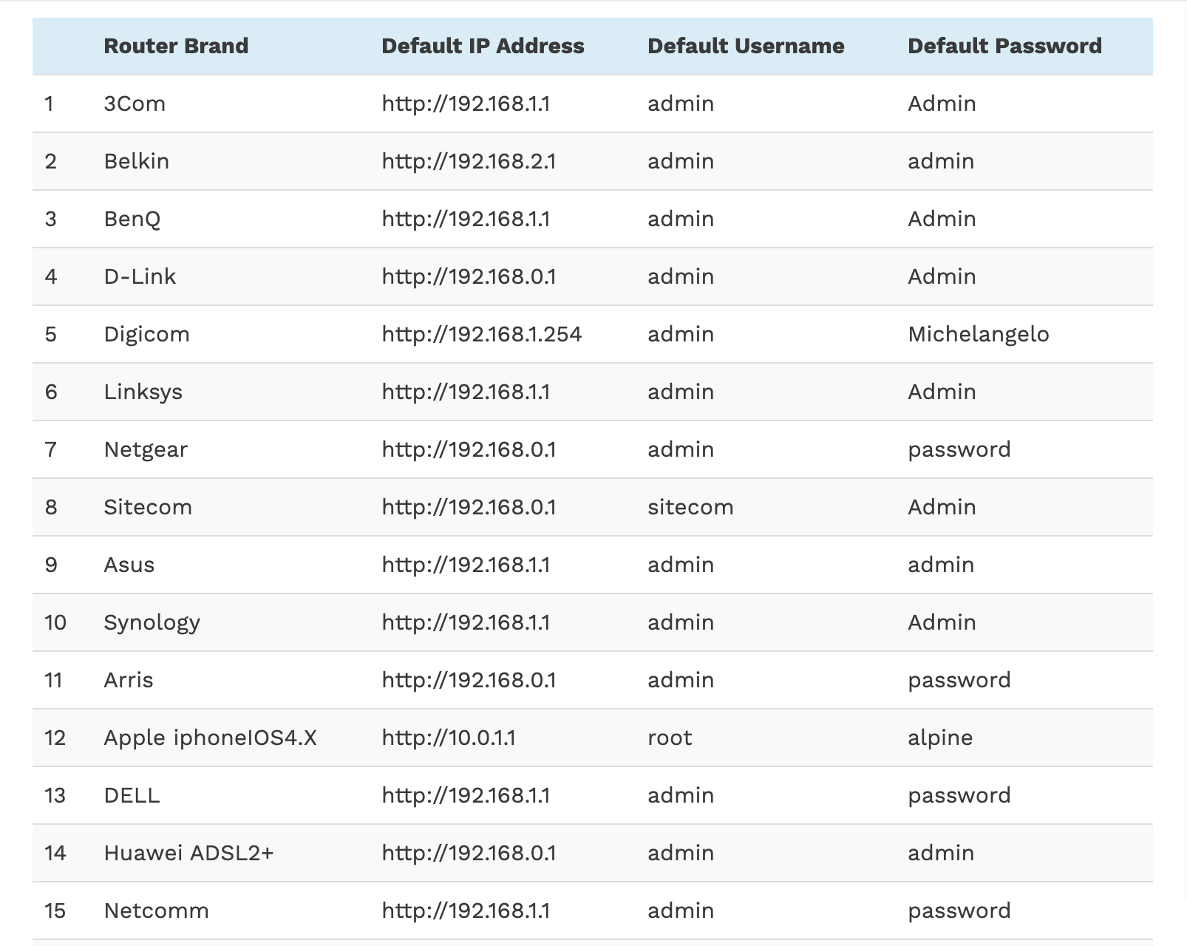
Example
Default router username and password list.
Picture source: https://www.softwaretestinghelp.com/default-router-username-and-password-list/

Slide 10
How do we manage vulnerabilities?
Software design principles
Design systems to avoid them.
Write secure code to reduce the number of them.
Add mitigation techniques to address them.
Analyze systems to find them.
Common vulnerabilities, Secure coding
Code auditing, code analysis tools, software security testing

Slide 11
outline
Software design principles
  Saltzer & Schroeder’s paper 1975
  Avoiding the Top 10 Software Security Design Flaws
Secure coding
Common software vulnerabilities
Code auditing
Static code analysis tools
Software security testing
  Fuzzing

Slide 12
Secure Programming design principles
Design principles from Saltzer & Schroeder’s 1975 paper.
  http://web.mit.edu/Saltzer/www/publications/protection/index.html
An updated version by Saltzer & Kaashoek in 2009.
  https://ocw.mit.edu/resources/res-6-004-principles-of-computer-system-design-an-introduction-spring-2009/online-textbook/part_ii_open_5_0.pdf
IEEE Center for Secure Design, “Avoiding the Top 10 Software Security Design Flaws”
  https://www.semanticscholar.org/paper/Avoiding-the-Top-10-Software-Security-Design-Flaws-Arce-Clark-Fisher/d2e6d308cdb84ea6f9dba062329b31887e4f941c
  http://web.cs.wpi.edu/~cs557/f14/papers/CybersecurityInitiative-online.pdf

Slide 13
Programming design principles
Three themes underlying them:
Simplicity
  less to go wrong
  fewer possible inconsistencies
  easy to understand
Restriction
  Minimize access
  inhibit communication
Methodology
Simplicity
Restriction
Methodology

Slide 14

1. Least Privilege (need to know)
Software [user/other system] should be given only those privileges that it needs to complete its task and only for the minimum time necessary.
  Minimal protection domain. (Protection domain: all objects to which the process has access and the type of access the process has.)
  Rights added as needed, discarded after use.
Notes:
Limits the damage that can result from an accident or error. It also reduces the number of potential interactions among privileged programs to the minimum for correct operation, so that the unintentional, unwanted, or improper used of privilege are less likely to occur. Thus, if a question arises related to misuse of a privilege, the number of programs that must be audited is minimized. If a mechanism can provide “firewalls” the principle of lease privilege provides a rationale for where to install the firewalls. The military security rule of “need to know” is an example of this privilege.

Slide 15
1. Least Privilege
Simplicity
Restriction
Methodology
Advantages:
Reduce risk of breach.
The security impact of a security incident or corruption of the component will be minimized.
The security analysis of the component will be simplified (that is, if you have to do forensic analysis on a breach, the analysis will be easier).
Protect the property of Confidentiality
people only get to see what they should get to see …

Slide 16

2. Fail-safe Defaults
Unless a subject is given explicit access to an object, it should be denied access to that object.
  Default action is to deny access.
  If action fails, system as secure as when action began.
Simplicity
Restriction
Methodology
Notes:
There are too many decisions to adequately consider, to a default of deny is the only prudent design choice.

Slide 17
2. Fail-safe Defaults
What happens when the system fails?
  Some system allow access or exhibit insecure behavior when a failure occurs.
The attacker then “just” has to figure out how to cause a failure.
If the subject is unable to complete its action or task, all interim changes should be undone and the security state restored prior to termination.

Slide 18
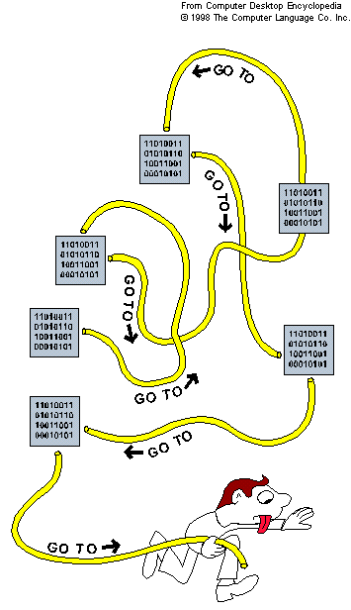
3. Economy Of Mechanism
Keep software design as small and simple as possible.
  Don’t add complexity
  KISS (Keep It Simple and Small)
  Simpler means less can go wrong
  When errors occur, they are easier to understand and fix.
Simplicity
Restriction
Methodology

Slide 19
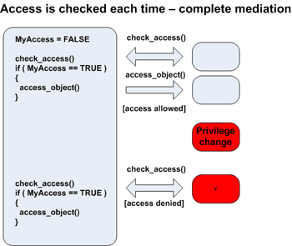
4. Complete Mediation
Software should validate every access to every object to ensure that the access is allowed.
  Whenever you make an access, check to be sure that is allowed.
Simplicity
Restriction
Methodology

Slide 20

5. Separation Of Privilege Principle
(Defense In Depth)
Software should not grant access to a resource, or take a security-relevant action, based upon a single condition.
  Sensitive operations should require the cooperation of more than one check.
  Eg.
    Banking: Two signatures on a large check.
    Military: Two people give the same command.
Simplicity
Restriction
Methodology

Slide 21
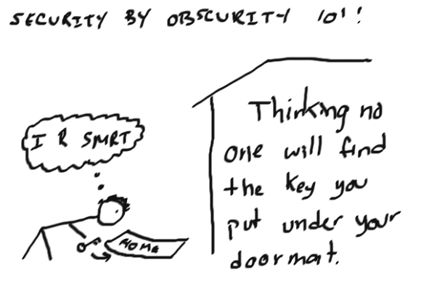
6. Open Design
Simplicity
Restriction
Methodology
Security of software and of what that software provides should not depend on the secrecy of its design or implementation.
  Security through obscurity.
  Security should not depend solely on secrecy of design or implementation.
  Does not apply to information such as password or cryptographic keys.
Pic source: https://www.linkedin.com/pulse/false-sense-security-obscurity-mikhail-mugotitsa-ceh-itil

Slide 22

7. Least Common Mechanism
Mechanisms used to access resources should not be shared.
  Shared mechanisms – especially involving shared variables – are potential paths between users that can compromise security.
Simplicity
Restriction
Methodology

Slide 23
8. Least Astonishment
Secure mechanisms should be designed so users understand why the mechanism works the way it does, and using mechanism is simple.
  Hide complexity introduced by security mechanisms
  Ease of installation, configuration and use
  Human factors critical
Simplicity
Restriction
Methodology

Slide 24
outline
Software design principles
  Saltzer & Schroeder’s paper 1975
  Avoiding the Top 10 Software Security Design Flaws
Secure coding
Common software vulnerabilities
Code auditing
Static code analysis tools
Software security testing
  Fuzzing

Slide 25
Secure Programming design principles
Design principles from Saltzer & Schroeder’s 1975 paper.
  http://web.mit.edu/Saltzer/www/publications/protection/index.html
An updated version by Saltzer & Kaashoek in 2009.
  https://ocw.mit.edu/resources/res-6-004-principles-of-computer-system-design-an-introduction-spring-2009/online-textbook/part_ii_open_5_0.pdf
IEEE Center for Secure Design, ”Avoiding the Top 10 Software Security Design Flaws”
  https://www.semanticscholar.org/paper/Avoiding-the-Top-10-Software-Security-Design-Flaws-Arce-Clark-Fisher/d2e6d308cdb84ea6f9dba062329b31887e4f941c
  http://web.cs.wpi.edu/~cs557/f14/papers/CybersecurityInitiative-online.pdf

Slide 26
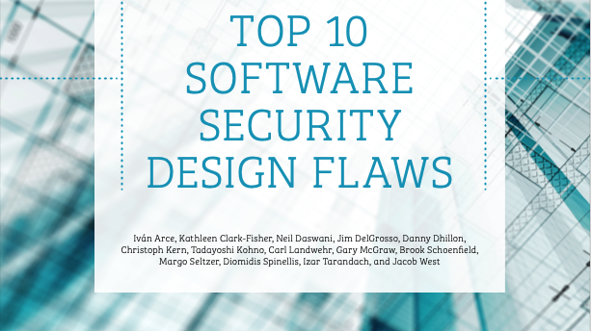
Earn or Give, but Never Assume, Trust
Use an Authentication Mechanism that Cannot be Bypassed or Tampered With
Authorize after You Authenticate
Strictly Separate Data and Control Instructions, and Never Process Control Instructions Received from Untrusted Source
Define an Approach that Ensures all Data are Explicitly Validated
Use Cryptography Correctly
Identify Sensitive Data and How They Should Be Handled
Always Consider the Users
Understand How Integrating External Components Changes Your Attack Surface
Be Flexible When Considering Future Changes to Objects and Actors

Slide 27

Principle #1
Use an authentication mechanism that cannot be bypassed or tampered with.

Slide 28
Principle #1:
Use An Authentication Mechanism That Cannot Be Bypassed Or Tampered With.
Example mechanisms for bypassing and tampering with authentication mechanisms
  The user can access the service by navigating directly to an “obscure” URL … security through obscurity
  The authentication mechanism uses assumptions about sole possession of resources (e.g IP address) that may actually be shared or spoofed.
  System tokens (such as session IDs) should not be deterministically derived from easy-to-obtain information, such as a username, then it becomes possible to forge identities, allowing users to impersonate other users.

Slide 29
Principle #2:
Authorize after you authenticate
Authorization is the act of checking that the entity (user or other system) is allowed or disallowed to perform certain actions based upon their authentication.
Access is the ability to do something with a computer resource (e.g., use, change, or view).
Access control is the process by which use of a system’s resources is regulated according to a security policy and is permitted by only authorized entities (users, programs, processes) according to that policy

Slide 30
Principle #3
External Components Change The Attack Surface
Software inherits the security weaknesses, security limitations, maintenance responsibilities, and threat model of any software it integrates.

Slide 31
Principle #3:
External Components Change The Attack Surface
Attack surface – the collection of all entry points that provide access to an asset.
  A house, an intruder.
  An OS, an attacker.

Slide 32
What kind of “components”?
  Off-The-Shelf components, platform, applications
  Third party open source or proprietary libraries
  Widgets and gadgets loaded at runtime as part of a web project
  Software developed by a different team
  Software your team developed at a different point in time
  ….
https://snyk.io/stateofossecurity/

Slide 33
Principle #3:
What to do?
  Remove software,
  Turn off certain features,
  Disable or remove unnecessary software features.
  Isolate components as much as possible
  Look at vulnerability history in CVE database
  Maintain up-to-date components
  Consider data coming in untrusted.
  ...
External Components Change The Attack Surface
Attack surface – the collection of all entry points that provide access to an asset.
  A house, an intruder.
  An OS, an attacker.

Slide 34

Principle #4:
Earn Or Give, But Never Assume, Trust
Software should check all inputs and the results of all security-relevant actions.
Even if users are known, they are susceptible to social engineering attacks and insider threat.
Make sure all data received from an untrusted client are properly validated before processing

Slide 35
Principle #5:
Define An Approach That Ensures All Data Are Explicitly Validated
Assume all input is malicious
Constrain, reject, and sanitize your input
Centralize your input filtering approach
Encrypt sensitive data
Use white list
...

Slide 36
Principle #6:
Strictly Separate Data And Control Instructions, And Never Process Control Instructions Received From Untrusted Sources.
Having data and control instructions in a single entity, especially a string, can lead to injection vulnerabilities.
  Examples of such vulnerabilities include SQL query injection, cross-site JavaScript injection, and shell command injection
Lack of strict separation between data and code can lead to untrusted data controlling the execution flow of a software system.

Slide 37

Principle #7:
Identify Sensitive Data And How They Should Be Handled
Comes from many sources
Users input
… and the Personally-identifiable information (PII) of users
Data computed
Sensors (e.g. geolocation, accelerometer)

Slide 38

Principle #7:
Identify Sensitive Data And How They Should Be Handled
Create a policy that explicitly identifies different levels of classification
Cryptography to preserve data confidentiality or integrity
Access control mechanisms
Redundancy
Data at rest
Data in transit
Data in use

Slide 39
Principle #8:
Use Cryptography Correctly
Through the proper use of cryptography, one can protect the confidentiality of data, protect data from unauthorized modification, and authenticate the source of data.

Slide 40
Principle #8:
Use Cryptography Correctly
Don’t create your own cryptographic algorithms or implementations.
Misuse of libraries and algorithms
Poor key management
  hard-coding keys into software (often observed in embedded devices and application software)
  failure to allow for the revocation and/or rotation of keys
  use of cryptographic keys that are weak (such as keys that are too short )
  weak key distribution mechanisms

Slide 41
Principle #8:
  Use Cryptography Correctly
Randomness that is not random
  Need random numbers with strong cryptographic randomness properties
  Cannot reuse random numbers
Failure to centralize cryptography choice within a team/organization
  Different cryptographic algorithms often don’t interact nicely.
Work with an expert, if possible

Slide 42
Principle #9:
Always Consider the Users
Similar to the “Least astonishment” principle.
Security features of software and the security mechanisms it implements should be designed so their operation is as logical and simple as possible.

Slide 43

Principle #10:
Be Flexible When Considering Future Changes To Objects And Actors
Plan the design in such a way that it can be changed, if needed.
This minimizes the effects with respect to the security of changing the design if the specifications do not match in an environment that the software is used in.
https://www.scnsoft.com/blog/software-development-life-cycle-examples

Slide 44
Earn or Give, but Never Assume, Trust
Use an Authentication Mechanism that Cannot be Bypassed or Tampered With
Authorize after You Authenticate
Strictly Separate Data and Control Instructions, and Never Process Control Instructions Received from Untrusted Source
Define an Approach that Ensures all Data are Explicitly Validated
Use Cryptography Correctly
Identify Sensitive Data and How They Should Be Handled
Always Consider the Users
Understand How Integrating External Components Changes Your Attack Surface
Be Flexible When Considering Future Changes to Objects and Actors

Slide 45
Software development life cycle (sdlc)
Software development life cycle describes phases of the software development cycle and the order in which those phases are executed.
How do we manage vulnerabilities – implementation stage?
  Write secure code to reduce the number of them.
Notes:
figure out a way to talk about secure coding with showing any code.
different language has its own pros and cons.

Slide 46
outline
Software design principles
  Saltzer & Schroeder’s paper 1975
  Avoiding the Top 10 Software Security Design Flaws
Secure coding
Common software vulnerabilities
Code auditing
Static code analysis tools
Software security testing
  Fuzzing

Slide 47
robust programming
Robust Programming (secure coding)
  A style of programming that prevents abnormal termination or unexpected actions.
  Handles bad input gracefully
  Detects internal errors and handles them gracefully.

Slide 48
Defensive programming
What could someone deliberately do to compromise your program?
  Adversary thinking
What could someone unintentionally do to compromise your program?
  People make mistakes
Defensive Programming uses a lot of techniques to ensure that when things go wrong, your program will behave properly.
  Input validation, type checking
  Cover all cases - use defaults to handle cases not explicitly covered
  Catch and handle exceptions at the lowest level possible
  ...
Notes:
To be able to implement a secure program. we need to think about these two questions.
In defensive driving, you assume other drivers will make mistakes that can lead to accidents involving your vehicle, so you take a proactive approach for protecting your car against those things, like driving extra carefully and always expecting people to do stupid stuff.

Slide 49
Demo: Score_system.cpp

Slide 50
all INPUT IS EVIL!
Any program input (user input from keyboard, a file, a network connection) can be the source of vulnerability.
All input should be treated as potentially dangerous.
Code responsibility – Input validation:
  1. Check your input
  2. Use appropriate tools/functions to get input
  3. Recover appropriately;
Notes:
reject it? default value? strip the bad character and only keep the good one?

Slide 51
Input validation
1. Check your input
  Type: input data should be of the right data type.
  Range: within a range of possible values (the values make sense)
  Length: too long or too short?
  Format: specific format? eg. Date, phone number, SSN
  ...

Slide 52
Input validation
2. Use safer function to get input
char* gets(char* str); ← Never use it
  The gets() function reads characters from stdin and stores them in str until a newline character or end of file is found.
  It is impossible to tell without knowing the data in advance how many characters gets() will read, and because gets() will continue to store characters past the end of the buffer, it is extremely dangerous to use.
  Two alternative functions to use: fgets() or getchar().

Slide 53
Input validation
3. Recover appropriately;
  Have proper message to indicate the problem.
  Drop the bad one and ask for a new one, until getting a valid input (preferred way).
  Parse it and make changes on the input (eg. drop certain characters/symbols...).
  Truncate it if the input is too long
  Terminate the program gracefully (not a good choice)
  ...

Slide 54
Unintentional Programming Oversights Vs. Malicious Code
Unintentional (Nonmalicious) Programming Oversights:
  Buffer overflow
  Integer overflow
  Incomplete mediation
  Off-by-one error
  Format string vulnerability
  Unsafe utility program
  ...
Malicious code or malware (malicious software) - Programs planted by an agent with malicious intent to cause unanticipated or undesired effects.

Slide 55
outline
Software design principles
Secure coding
Common software vulnerabilities
  buffer overflow
  integer overflow
Code auditing
Static code analysis tools
Software security testing

Slide 56
Memory Corruption
Memory Corruption can be described as the vulnerability that may occur in a computer system when the contents of a memory location are altered due to explicit assignment.
Buffer Overflows are the most common type of memory corruption.
A Buffer Overflow is a software bug in which data copied to a location in memory exceeds the size of the reserved destination area. When an overflow is triggered, the excess data overwrites the adjacent memory locations.

Slide 57
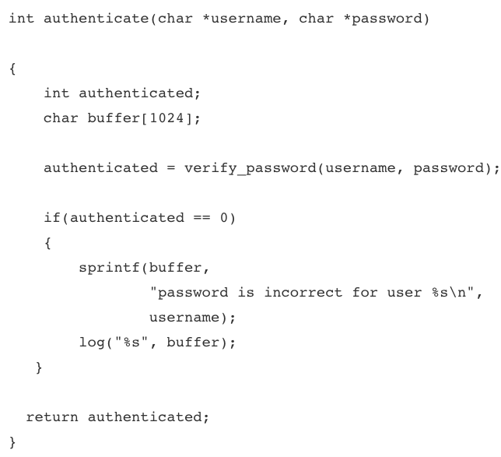
Example:
Buffer overflow

Slide 58
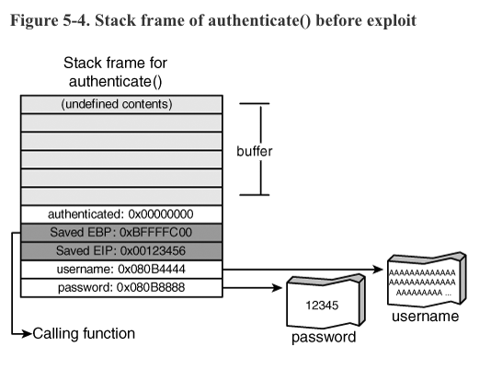
Example:
Buffer overflow

Slide 59
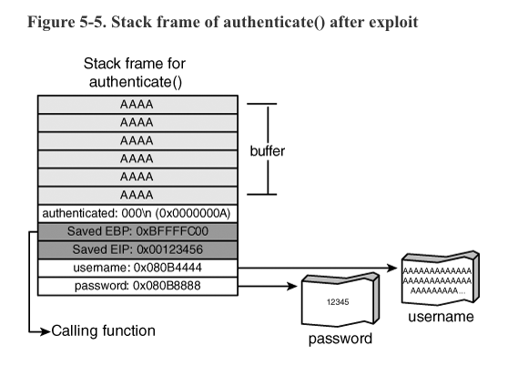
Example:
Buffer overflow

Slide 60
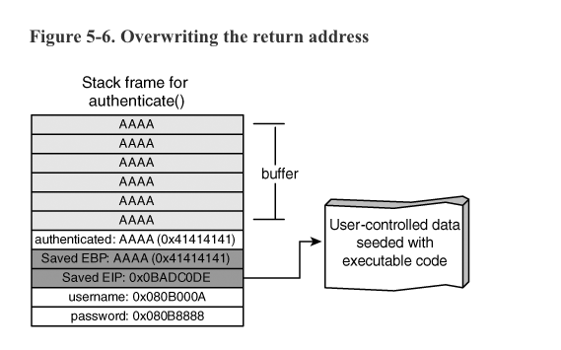
Example:
Buffer overflow

Slide 61
overwrite the return address
Execution can be redirected to an area of memory containing data the attacker controls.
The attacker fills the targeted return location with some code to do something (eg, connecting back to the attacker, run the shell)
In hacking, a shellcode is a small piece of code used as the payload in the exploitation of a software vulnerability. It is called "shellcode" because it typically starts a command shell from which the attacker can control the compromised machine, but any piece of code that performs a similar task can be called shellcode.

Slide 62
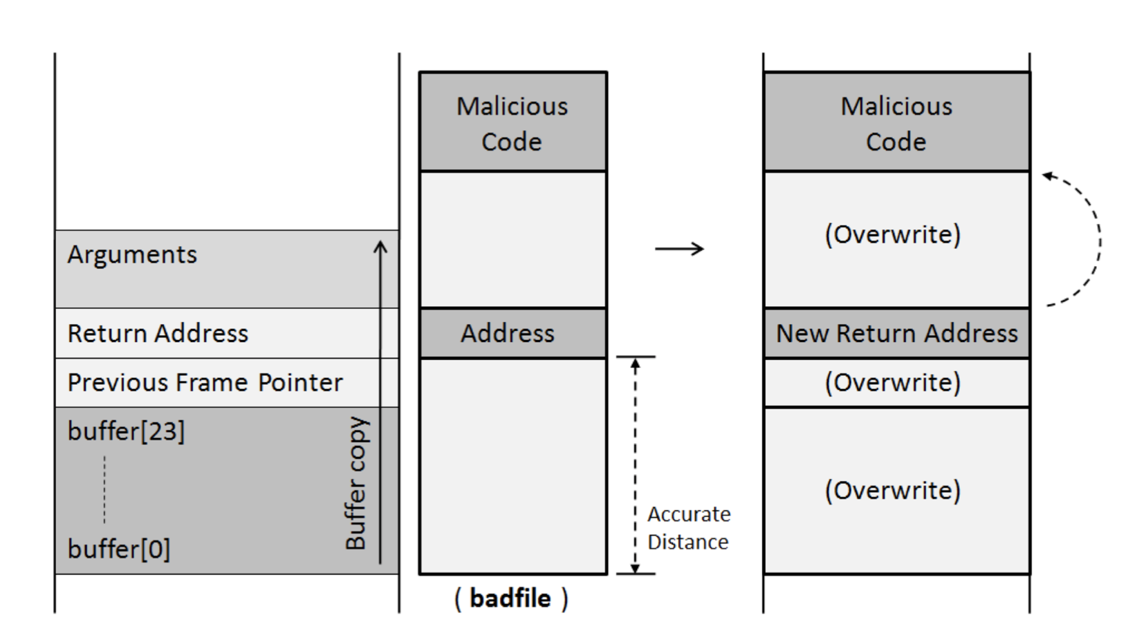
overwrite the return address

Slide 63
data type in c/c++

Slide 64
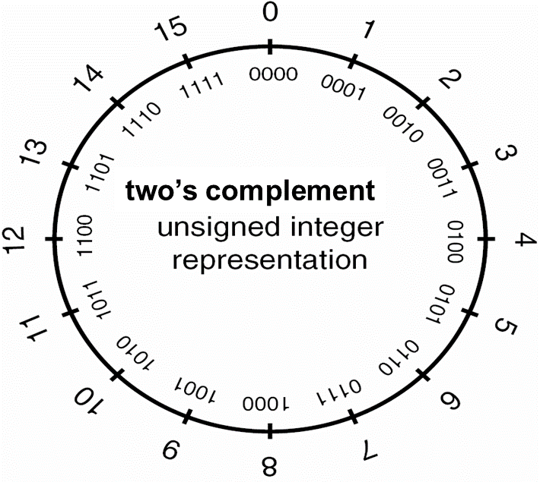
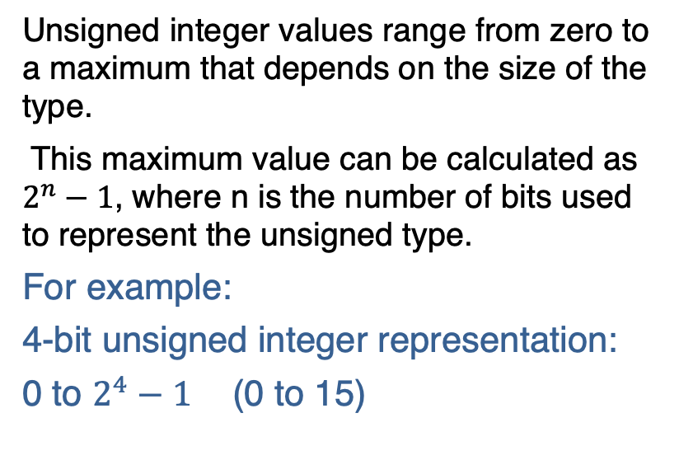
Unsigned Integers
Unsigned integer values range from zero to a maximum that depends on the size of the type.
This maximum value can be calculated as $2^{n}−1$, where n is the number of bits used to represent the unsigned type.
For example:
4-bit unsigned integer representation:
0 to $2^{4}−1$ (0 to 15)

Slide 65
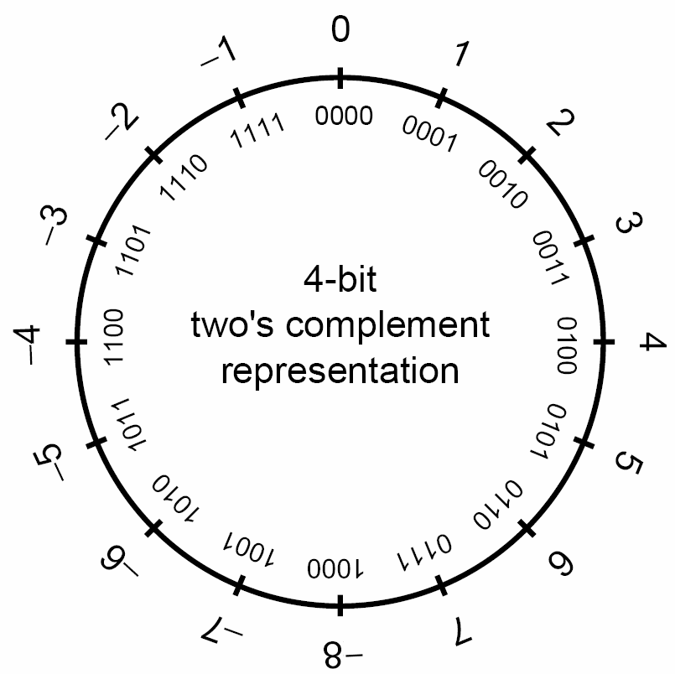
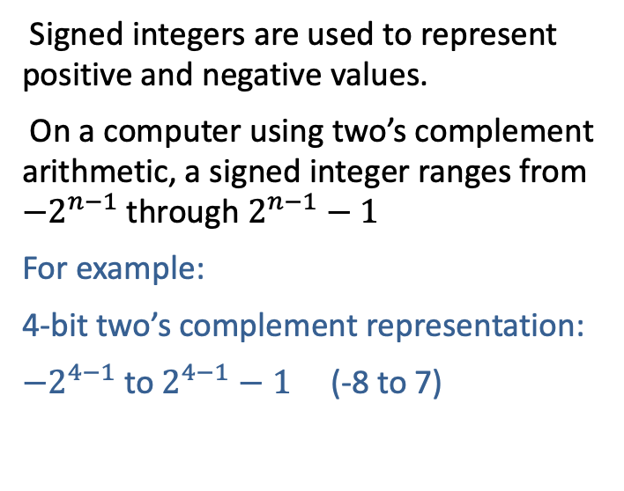
Signed Integers
Signed integers are used to represent positive and negative values.
On a computer using two’s complement arithmetic, a signed integer ranges from ${−2}^{n−1}$through $2^{n−1}−1$
For example:
4-bit two’s complement representation:
${−2}^{4−1}$to $2^{4−1}−1$ (-8 to 7)

Slide 66
Two’s Complement (Max and Min)
For example:
8-bit unsigned integer:
Max: 1111 1111 = 255
Min: 0000 0000 = 0
8-bit signed integer:
Max: 0111 1111 = 127
Min: 1000 0000 = -128
Notes:
Max: 0111 1111 = 127,
Min: 1000 0000 = -128

Slide 67
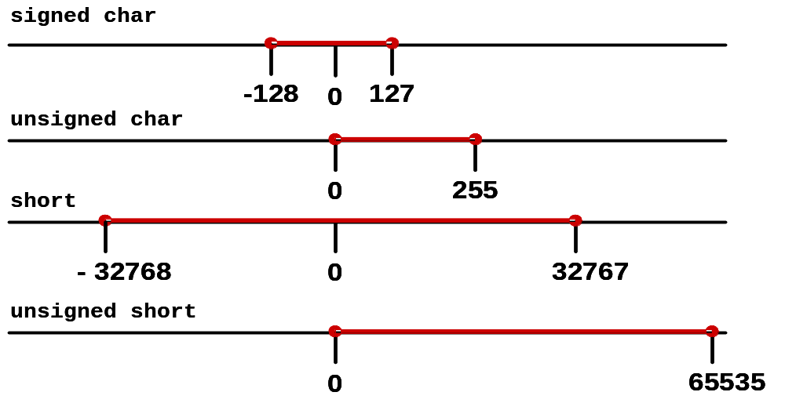
Example Integer Ranges

Slide 68
integer overflow
C’s basic integer types have minimum and maximum possible values determined by their underlying representation in memory.
Simple arithmetic on a variable, such as addition, subtraction, or multiplication, can result in a value that can’t be held in that variable.
When an arithmetic operation results in a value higher than the maximum possible representable value, it’s called integer overflow.
idea is similar to:
(using 4 digits to represent)
7000
+ 8000
= 15000

Slide 69
outline
Software design principles
Secure coding
Common software vulnerabilities
Code auditing
  Code auditing and its process
  Code auditing strategies
Static code analysis tools
Software security testing

Slide 70
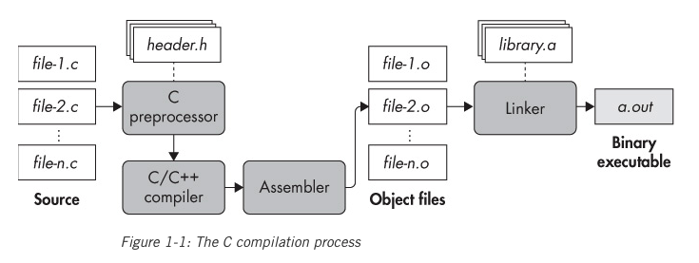
source code and executable
How binary executables are produced from source?
Compilation – the process of translating human-readable source code into machine code that your computer can execute.
Interpreter – translates a program one line at a time, as the computer is running the program.
Notes:
There are also languages such as Python and JavaScript in which programs are interpreted on the fly rather than compiled as a whole. Sometimes parts of interpreted code are compiled just in time (JIT), as the program executes. This produces binary code in memory, which you can analyze using the techniques discussed in this book. Since analyzing interpreted languages requires language-specific specialized steps, I won’t go into detail on this process.

Slide 71
Code auditing - Outline
Code auditing and its process
  Preassessment
  Application Review
  Documentation and Analysis
Code auditing strategies
  Code Comprehension (CC) Strategies
  Candidate Point (CP) Strategies
Static code analysis
  Demo: static code analysis tool - flawfinder
  Virus, worm, trojan horse

Slide 72
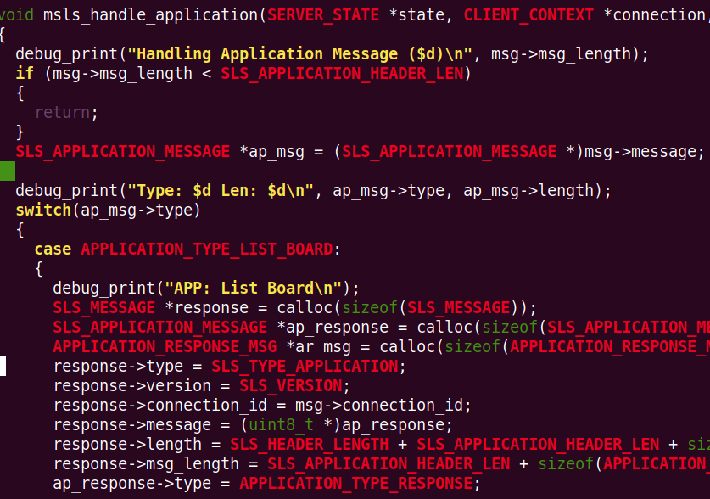
Code auditing
Code auditing: comprehensive analysis of source code.
Code auditing process:
  Preassessment
  Application Review
  Documentation and Analysis
Notes:
Is the code does what it suppose to do?
Any flaws, bugs in it?

Slide 73
Preassessment (1)
Scoping -- what is the goal?
  Catch the easy to find vulnerabilities?
  Focus on specific security-related module (authentication, encryption)
  Complete review
Application Access: What do you have?
  Source Only
  Binary Only
  Source and Binary
  Checked Build (binary with debug information)
  True Black Box
Notes:
There are some questions we want to answer before actually doing the job.

Slide 74

Preassessment (2)
Timelines
  How much time do you have?
  Some code harder than others. Why?
Information Collection
  Developer Interviews
  Developer Documentation
  Standards Documentation
  ...
pic source: http://emblazoners.com/lessons-learned-from-my-flat-iron-no-time-like-the-present/

Slide 75
Application Review (1)
Design Review
  Very useful for prioritizing and scoping, however…
  May not have any design documentation
  Design Documentation may be very outdated
  Might be a third party involved who does not want to share documents
  Developers may not be available? Why?
  Clients may not want to pay for design review. Why?

Slide 76

Application Review (2)
Avoid Drowning
  Use different techniques and switch between them
    Can only intensely concentrate for limited amount of time
    Different vulnerabilities may require different perspectives
    Variety helps you maintain discipline and motivation
    Different people think in different ways
Iterative Process
  Plan
  Work
  Reflect

Slide 77
Application Review (3)
Initial Preparation for a Plan
  Get your bearings
  Decide on review structure (top-down, bottom-up, hybrid)
  Determine the following
    General application purpose
    Assets and entry points
    Components and modules
    Intermodule relationships
    Fundamental security expectations
    Major trust boundaries

Slide 78
Application Review (4)
The Plan
  Decide on Audit Strategy
  Consider your Goals
  Pick the “right strategy”
  Create a “Master Ideas List”
  Pick a Target of Goal
  Coordinate with Others

Slide 79

Work (1)
Take Notes – “Working Papers”
  Help you stay organized and ensure proper code coverage
  Easy way to transfer knowledge to others and to coordinate work
  Clients expect detailed documentation
  Application may require follow-up reviews
  Notes should be clear enough that others could approximate your work
  Note should be clear enough for you to use if there is a large gap in time between visits to that part of code
  Notes should be clear enough to establish code and vulnerability-type coverage.

Slide 80

Work (2)
Avoid falling down rabbit holes
  What do we mean by this?
  Why avoid this?
Take breaks as needed
Pic source: http://www.alpenglowbenefits.com/social-media-awesome/rabbit-hole/

Slide 81
Reflect (1)
Step back, review and update your notes
Status check
  What have you learned about the application? Write it down
  Are you focusing on the most security-relevant components?
  Have you gotten stuck on any tangents or gone down any rabbit holes?
  Does your master ideas list have many plausible entries?
  Have you been taking adequate notes and recorded enough detail for review purposes?
  If you are working from application models and documentation, do they reflect the implementation accurately?
Notes:
still on track

Slide 82
Reflect (2)
Re-evaluate
  What to do if top-down approach (or other approach) failed?
  Are your goals correct?
  Did you understand the application?
  What if you found/or didn’t find a vulnerability?
Peer Reviews
  Have a team partner review your work

Slide 83
Documentation and Analysis (1)
Need to document results.
  Threat
  Location of vulnerability
  Vulnerability class
  Vulnerability description
  Prerequisites
  Business impact
  Remediation/mitigation
  Risk
  Severity
  Probability

Slide 84
Summary: Code Auditing Process
Preassessment
  What is the goal? Timeline?
  What do you have? (source, binary, checked build, true black box...)
  Information collection (developer interviews, developer documentation)
Application Review
  Plan: audit strategy? coordinate with others, pick a target...
  Work: take good note (working papers), Avoid drowning, rabbit hole
  Reflect: status check, re-evaluate, peer reviews
  Iterative process (Plan, work, reflect ...)
Documentation and Analysis
  Need to document results (threat, location, impact, risk, severity...)

Slide 85
Code auditing - Outline
Code auditing and its process
  Preassessment
  Application Review
  Documentation and Analysis
Code auditing strategies
  Code Comprehension (CC) Strategies
  Candidate Point (CP) Strategies
Static code analysis
  Demo: static code analysis tool
  Virus, worm, trojan horse

Slide 86
Code auditing strategies
Two main categories of source code auditing strategies:
  Code Comprehension (CC) Strategies
    Analyze source code directly
      to discover vulnerabilities
      to improve understanding of code
  Candidate Point (CP) Strategies
    Create list of potential issues
    Examine source code to determine relevance of issues

Slide 87
Code Comprehension Strategies
Code Comprehension (CC) Strategies
  Discovering vulnerabilities by directly analyzing the code.
  Require you to read the code and understand it.
  Need to keep good “working paper”, take breaks if needed.

Slide 88
Code Comprehension Strategies
CC1: Tracing malicious input
  Start at data entry point to the system, searching for any type of behavior that appears unsafe
    Basically, keep set of “malicious input” in the back of your mind as you read the code
  Goal: discover security problems that can be caused by malicious input
Notes:
get tired or impatient
time consuming
common vulnerability classes

Slide 89
Code Comprehension Strategies
Code Comprehension (CC) Strategies
  Discovering vulnerabilities by directly analyzing the code.
  Require you to read the code and understand it.
  Need to keep good “working paper”, take breaks if needed.
Advantages:
  Have a better view of the program
  May catch some subtle problems.
Disadvantages:
  Time consuming, get tired easily

Slide 90
Candidate Point (CP) Strategies
Candidate point – a piece of code which represents a potential vulnerability.
Identify code patterns commonly associated with software vulnerabilities, and then trace back
Candidate point strategies:
  1. create a list of potential issues through some mechanism or process.
  2. examine the source code to determine the relevance of these issues.
Notes:
advan: fast, and simple
disad1: these strategies don’t encourage a strong understanding of the code
disad2: ignore vulnerabilities that don’t fit the rather limited candidate point definitions.

Slide 91
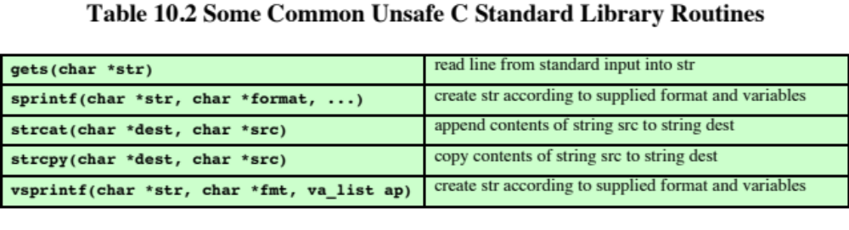
Unsafe utility functions in C
High risk: gets(), strcpy(), sprintf(), strcat(), vsprintf() …

Slide 92
Candidate Point Strategies
CP2: Automated source analysis tool
  Goal: identify vulnerabilities based on a list of candidate points and code paths obtained from automated analysis tools.
  Trace backward to the code, control flow sensitive, data flow sensitive
Strengths: Good coverage for easily identified vulnerabilities
Not too difficult
Hard to get off track
Weaknesses: The results are only as good as your tool
Notes:
The source analysis tool may be limited in the classes of vulnerabilities they can detect

Slide 93
Candidate Point (CP) Strategies
Candidate point – a piece of code which represents a potential vulnerability.
Candidate point strategies:
  1. create a list of potential issues through some mechanism or process.
  2. examine the source code to determine the relevance of these issues.
Advantages: simple and fast
Disadvantages:
  These strategies don’t encourage a strong understanding of the code.
  Ignore vulnerabilities that don’t fit the rather limited candidate point definitions.
Notes:
advan: fast, and simple
disad1: these strategies don’t encourage a strong understanding of the code
disad2: ignore vulnerabilities that don’t fit the rather limited candidate point definitions.

Slide 94
Code auditing - Outline
Code auditing and its process
  Preassessment
  Application Review
  Documentation and Analysis
Code auditing strategies
  Code Comprehension (CC) Strategies
  Candidate Point (CP) Strategies
Static code analysis
  Demo: static code analysis tool
  Virus, worm, trojan horse

Slide 95
Static code analysis
Static Code Analysis (also known as Source Code Analysis) is usually performed as part of a Code Review and is carried out at the Implementation phase of a Security Development Life Cycle (SDLC).
Static Code Analysis commonly refers to the running of Static Code Analysis tools that attempt to highlight possible vulnerabilities within source code.
ref: https://owasp.org/www-community/controls/static_code_analysis
Notes:
Many types of security vulnerabilities are very difficult to find automatically, such as authentication problems, access control issues, insecure use of cryptography, etc.

Slide 96
Static code analysis
Strengths
  Scales Well (Can be run on lots of software, and can be repeatedly (like in nightly builds))
  For things that such tools can automatically find with high confidence, they are great.
Weaknesses
  Many types of security vulnerabilities are very difficult to find automatically.
  High numbers of false positives.
  Many of these tools have difficulty analyzing code that can’t be compiled.

Slide 97
dEMO - flawfinder (for C/C++) https://dwheeler.com/flawfinder/
Make sure you have pip installed
  sudo apt-get install python-pip
Install flawfinder
  sudo pip install flawfinder
Run test case
  flawfinder test.c

Slide 98
outline
Software design principles
Secure coding
Common software vulnerabilities
Code auditing
Static code analysis tools
Software security testing

Slide 99
Software Testing
Software testing consists of the dynamic verification that a program provides expected behaviors on a finite set of test cases, suitably selected from the usually infinite execution domain.
  Dynamic: This term means that testing always implies executing the program on selected inputs.
Static Code Analysis commonly refers to the running of Static Code Analysis tools that attempt to highlight possible vulnerabilities within source code without executing it.
Notes:
Static analysis vs. dynamic analysis
Static analysis techniques reason about a binary without running it.
Pros: Don’t need a CPU that can run the binary.
Cons: No knowledge of the binary’s runtime state, challenging.
Dynamic analysis executes the binary and analyzes it as it executes.
Pros: Have full knowledge of the entire runtime state.
Cons: You see only the executed code, may miss other parts of the program.

Slide 100
Types of testing
Smoke Testing | Smoke Testing, also known as “Build Verification Testing”, is a type of software testing that comprises of a non-exhaustive set of tests that aim at ensuring that the most important functions work.
Functional Testing | Functional Testing is a type of software testing whereby the system is tested against the functional requirements/specifications.
Usability Testing | Usability Testing is a type of software testing done from an end-user’s perspective to determine if the system is easily usable.
Security Testing | Security Testing is a type of software testing that intends to uncover vulnerabilities of the system and determine that its data and resources are protected from possible intruders.
Performance Testing | Performance Testing is a type of software testing that intends to determine how a system performs in terms of responsiveness and stability under a certain load.
Regression Testing | Regression testing is a type of software testing that intends to ensure that changes (enhancements or defect fixes) to the software have not adversely affected it.
Compliance Testing | Compliance Testing [also known as conformance testing, regulation testing, standards testing] is a type of testing to determine the compliance of a system with internal or external standards.
ref: http://softwaretestingfundamentals.com

Slide 101
Software Testing Methods
Black Box Testing
A software testing method in which the internal structure/design/implementation of the item being tested is not known to the tester. These tests can be functional or non-functional, though usually functional.
White Box Testing
A software testing method in which the internal structure/design/implementation of the item being tested is known to the tester.
Gray Box Testing
A software testing method which is a combination of Black Box Testing method and White Box Testing method.

Slide 102
Fuzzing
Fuzzing (fuzz testing) is a software testing technique which uses a fuzzing tool (fuzzer) to randomly generate or mutate input strings. The input are then fed to programs and the execution of the program is monitored for exceptions.
  input strings – usually invalid, unexpected or random data
  fuzzing is an automated technique.
The term ”fuzzing” is originated from a tool proposed by Barton Miller et al. [1]. The tool was used to fuzz testing Unix utility programs.
  25% to 33% of UNIX utility programs were successfully crashed by the tool

Slide 103
Weaknesses in Fuzzers
Some parts of code won't be hit by a fuzzer
  Because it requires special input values
  Because it needs to follow specific path

Slide 104
Traditional fuzzing vs. smart fuzzing
Traditional fuzzing: blank box, random input
Smart fuzzing: fuzzing is guided by other technique(s)
Input often requires structures/format
  HTML, XML, pdf files, …
The success and performance of fuzzers depend greatly on the information available to the fuzzer.
  eg, it helps if source information is available or if the program’s expected input format is known.
  fuzzing can require a lot of compute time and may not reach code hidden behind complex sequences of if/else conditions that the fuzzer fails to “guess”.
The longer you run, the more bugs you may find

Slide 105
Fuzzing
Broadly speaking, fuzzers fall into two categories:
  Generation-based fuzzers: generates inputs from scratch (possibly with knowledge of the expected input format)
  Mutation-based fuzzers: generates inputs by mutating known valid inputs in some way.
Notes:
Based on how they generate inputs

Slide 106
Mutation-Based Fuzzing
Take a well-formed input, randomly mutate (flipping bit, remove NUL, shift character forward…)
Little or no knowledge of the format of the inputs
Strengths
  Super easy to setup and automate
  Little to no protocol knowledge required
Weaknesses
  Limited by initial corpus

Slide 107
Generation-Based Fuzzing
Test cases are generated from some description of the format.
  Specified protocols
  file format (XML, pdf…)
  knowledge of protocol should give better results than random fuzzing
Strengths
  completeness
  Can deal with complex cases
Weaknesses
  Have certain knowledge of the testing program
  Writing generator can be labor intensive for complex protocols

Slide 108
How much fuzz is enough?
Mutation based fuzzers may generate an infinite number of test cases... When has the fuzzer run long enough?
Generation based fuzzers may generate a finite number of test cases. What happens when they’re all run and no bugs are found?
Code coverage may be a good way to indicate it.

Slide 109
Code coverage
Code coverage is a metric which can be used to determine how much code has been executed.
For example:
  gcov—a Test Coverage Program [2]
  gcov is a tool you can use in conjunction with GCC to test code coverage in your programs.
Types of code coverage:
  Line coverage
  function/method coverage
  branch coverage
  path coverage
  …
Notes:
Line coverage: percentage of source code lines executed by test cases.
Branch coverage
Measures how many branches in code have been taken (conditional jmps)
Path coverage
Measures how many paths have been taken

Slide 110
path coverage
x > y
path coverage:
4 test cases
eg.
x>y: true, m>n: true
x>y: true, m>n: false
x>y: false, m>n: true
x>y: false, m>n: false
true
false
y = 0
x = 0
m > n
true
false
n = 0
m = 0

Slide 111
Code coverage
Benefits:
  tells how good is the test file
  compare different fuzzers
  can identify paths through the code that may have missed
  can be used to guide fuzzing
Problems:
  code can be covered without triggering bugs

Slide 112
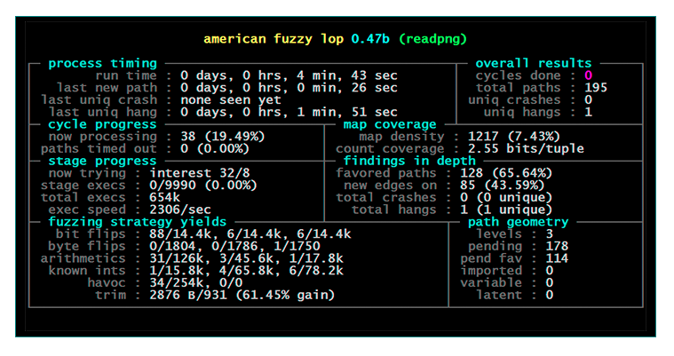
AFL
“American fuzzy lop is a security-oriented fuzzer that employs a novel type of compile-time instrumentation and genetic algorithms to automatically discover clean, interesting test cases that trigger new internal states in the targeted binary.” [4]

Slide 113
References
[1] Barton P. Miller, Louis Fredriksen, and Bryan So. 1990. An Empirical Study of the Reliability of UNIX Utilities. Commun. ACM 33, 12 (Dec. 1990), 32–44.
[2] gcov, https://gcc.gnu.org/onlinedocs/gcc/Gcov.html
[3] Dennis Andriesse, Practical binary analysis build your own linux tools for binary instrumentation, analysis, and disassembly. no starch press, 2019
[4] AFL, https://lcamtuf.coredump.cx/afl/

Slide 114
Please attribute Dr. Jim Alves-Foss and Dr. Jia Song, University of Idaho
Except where otherwise noted, this work is licensed under https://creativecommons.org/licenses/by-nc-sa/4.0/
Not withstanding the non-commercial license terms, non-profit educational institutions are granted a non-exclusive license to adapt and use this material, with attribution.
Creative Commons and the double C in a circle are registered trademarks of Creative commons in the United States and other countries. Third party marks and brands are the property of their respective holders.

